Slide 1
Dimensionality Reduction & Principal Component Analysis
slides adapted from Princeton Picasso group

Slide 2
Clustering
$$$
age
Does this still work with high-dimensional data?

Slide 3
Recall: Curse of Dimensionality
Coined by Bellman in 1961
Arises when analyzing and organizing data in high-dimensional spaces
Does not occur in low-dimensional settings
What is high-D?
high dimensional: hundreds, thousands of dimensions
low dimensional: usually <10

Slide 4
Principal Component Analysis (PCA)
Unsupervised learning method
Learns underlying factors that govern observed data
Often used for high-dimensional data
Example: Images (resolution 640x480)
~300,000-D data
However, we can describe the content of images with much more compact feature representation
We want to identify and use the (low-d) latent factors rather than the (high-d) observed data

Slide 5
PCA Sketch
Y
PCA₁
Provides low-D representation of data
Finds linear correlations
X
(x_{i}, y_{i})
(p_{i})
Notes:
“The most well-known dimensionality reduction method is PCA”

Slide 6
Basic Concept
If two dimensions (or attributes) are highly correlated
They are likely to represent highly related phenomena
If they tell us about the same underlying variance in the data, combining them to form a single measure may be reasonable
We want a smaller set of variables that explain most of the variance in the original data
In more compact and insightful form

Slide 7
Basic Concept (cont’d)
What if the dependences and correlations are not so strong or direct?
And suppose you have 3 variables, or 4, or 5, or 10000?
Look for the phenomena underlying the observed covariance/co-dependence in a set of variables
Once again, phenomena that are uncorrelated or independent, and especially those along which the data show high variance
These phenomena are called factors or principal components

Slide 8
Principal Component Analysis
Most common form of factor analysis
New variables/dimensions
Are linear combinations of the original ones
Are uncorrelated with one another
Orthogonal in original dimension space
Capture as much of the original variance in the data as possible
Are called Principal Components

Slide 9
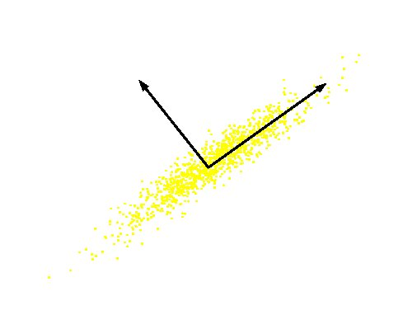
Principal Components
First principal component is the direction of greatest variability (covariance) in the data
Second is the next orthogonal (uncorrelated) direction of greatest variability
So first remove all the variability along the first component, and then find the next direction of greatest variability
And so on …
Original Variable B
PC 2
PC 1
Original Variable A

Slide 10
Computing the Components
Projection of vector x onto an axis (dimension) u is ux
Direction of greatest variability is that in which the average square of the projection is greatest
I.e. u such that E((ux)²) over all x is maximized
Note: We subtract the mean along each dimension, and center the original axis system at the centroid of all data points, for simplicity
This direction of u is the direction of the first Principal Component

Slide 11
Computing the Components
The matrix C = xx^{T} contains the correlations of the original axes
E((ux)²) = E ((ux) (ux)^{T}) = E (u^{T}xx ^{T}u)
Maximize u^{T}xx^{T}u such that u^{T}u = 1
Construct Lagrangian u^{T}xx^{T}u – λu^{T}u
Vector of partial derivatives set to zero
xx^{T}u – λu = (xx^{T} – λI) u = 0
As u ≠ 0 then u must be an eigenvector of xx^{T} with eigenvalue λ
Can we find these eigenvectors quickly?

Slide 12
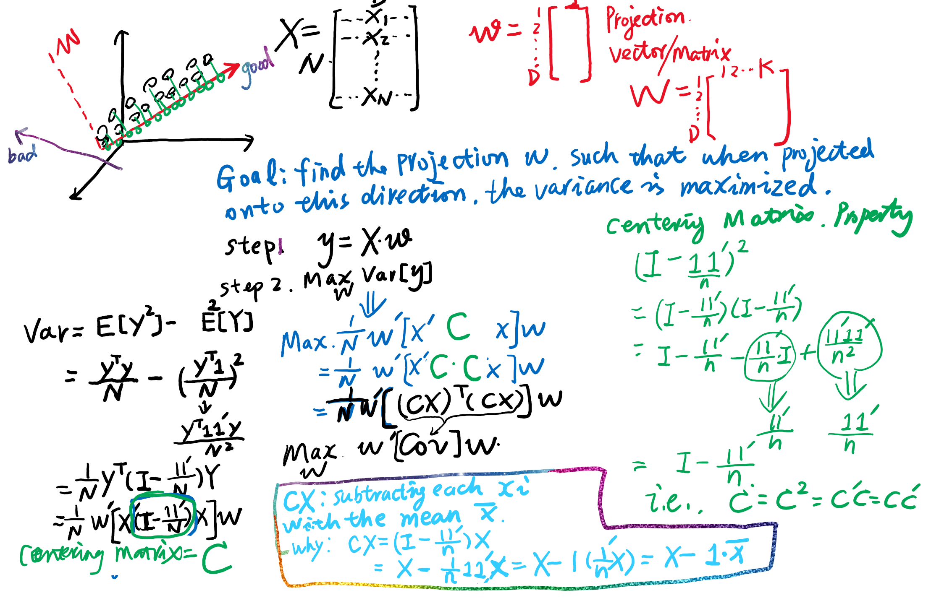
1-dimensional
k-dimensional

Slide 13
Singular Value Decomposition (SVD)
The first root is called the principal eigenvalue which has an associated eigenvector u
Subsequent roots are ordered such that λ₁> λ₂ >… > λ_{M}

Slide 14
SVD (cont’d)
The eigenvalue decomposition of xx^{T} = UΣU^{T}
where U = [u₁, u₂, …, u_{M}]
and Σ = diag[λ ₁, λ ₂, …, λ _{M}]
Similarly, x^{T}x = VΣV^{T}
The SVD is closely related to the above: x=U Σ^{1/2} V^{T}
The left eigenvectors U, right eigenvectors V
singular values = square root of eigenvalues

Slide 15
Computing the Components
So, the new axes are the eigenvectors of the matrix of correlations of the original variables
Captures the similarities of the original variables based on how data samples project to them
Geometrically: centering followed by rotation
Linear transformation

Slide 16
PCs, Variance and Least-Squares
The first PC retains the greatest amount of variation in the sample
The k^{th} PC retains the k^{th} greatest fraction of the variation in the sample
The k^{th} largest eigenvalue of the correlation matrix C is the variance in the sample along the k^{th} PC
The least-squares view: PCs are a series of linear least squares fits to a sample, each orthogonal to all previous ones

Slide 17
How Many Principal Components?
For n original dimensions, correlation matrix is nxn, and has up to n eigenvectors.
So n Principal Components
Can this be less than n? greater?
Where does dimensionality reduction come from?

Slide 18
Dimensionality Reduction
Can ignore the components of lesser significance
You do lose some information, but if the eigenvalues are small, you don’t lose much
n dimensions in original data
calculate n eigenvectors and eigenvalues
choose only the first p eigenvectors, based on their eigenvalues
final data set has only p dimensions

Slide 19
PCA with Image Data: Eigenfaces
Input: Digital Images of Faces
Goal: Usual machine learning problems
Is this a picture of Joe? (Classification)
Are these pictures of the same person? (Clustering)
Eigenfaces: Algorithm used to model image data (of human faces)
Why PCA?
To model the (low-d) latent parameters that correspond to the (high-d) images
Eigenfaces are the ‘standardized face ingredients’ derived from the statistical analysis of many pictures of human faces
A human face may be considered to be a combination of these standard faces

Slide 20

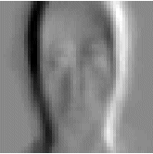
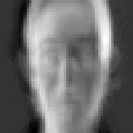
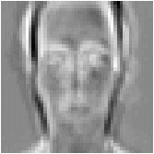
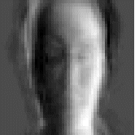
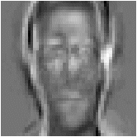
Eigenfaces
Low Dimensional Representation
PCA
=
a₁×
+
a₂×
+
a₃×
+
a₄×
+
+
+
a_{n}×

Slide 21
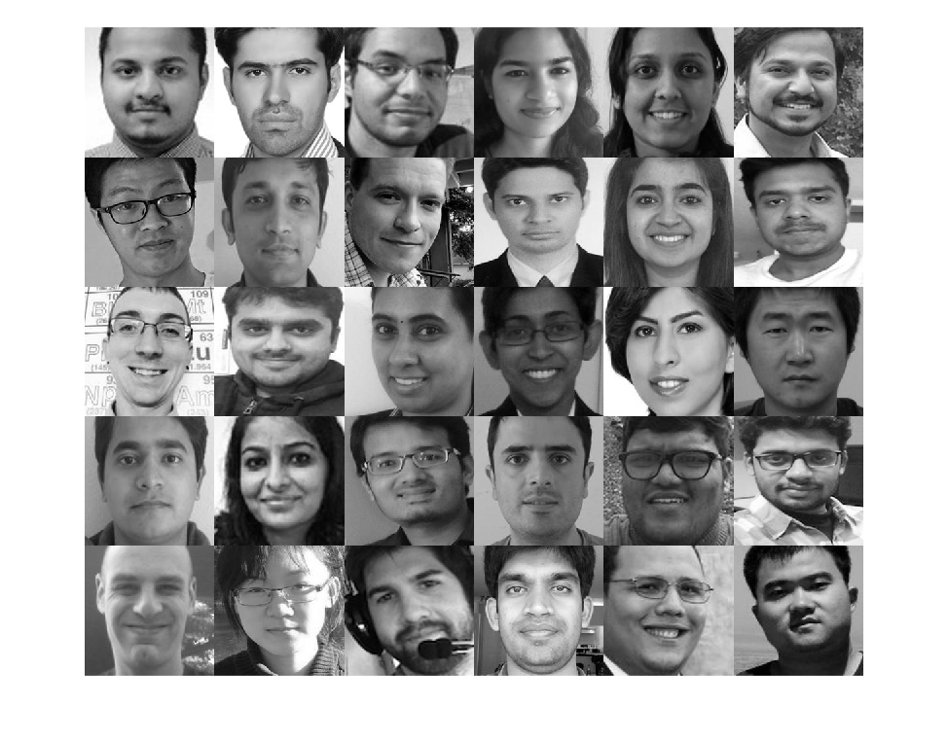

Slide 22
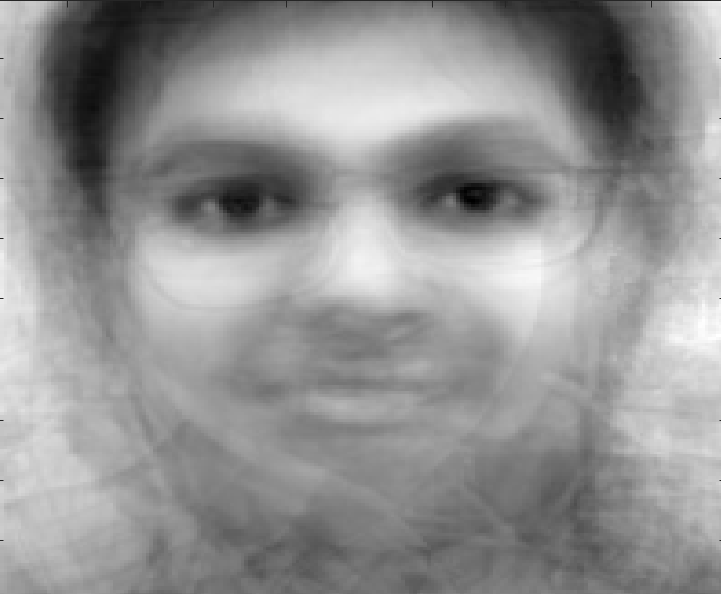
Centering the Data
Computing the mean of the data set
This is the “average” image
The average intensity at each pixel location
For a large enough group of people, this type of “ghost” is a common average

Slide 23
PCA Input = Original - Average

Slide 24
Linear Combinations of Images
For this data set, these are the (first three) principal components:
Recall that a principal component is a vector in feature space
If the feature vectors are images, the principal components can be viewed as images

Slide 25
Eigenfaces: Dimensionality Reduction
Eigenfaces provide a means of applying data compression (dimensionality reduction) to faces for identification purposes
Input: Image (high-dimensional, # of pixels)
Output: (low-d) vector of PCA coordinates
Eigenfaces can be summed together to create an approximate rendering of a human face

Slide 26


Eigenfaces: Dimensionality Reduction
We can represent an image as the avg. image + “how much of each principal vector it uses”
=
6.30 -1.61 -4.23
+
Avg Image
1.79 1.13 0.63
=

Slide 27
Eigenfaces: Reconstruction
What does this combination look like?
6.30 -1.61 -4.23 =
+
Avg Image
1.79 1.13 0.63 =

Slide 28
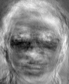
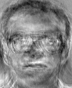
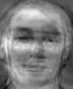
Eigenfaces for Recognition
ORL database of faces
Facial images of 16 persons each with 10 views are used
Variations in lighting and facial expression
Training set contains 16×7 images.
Test set contains 16×3 images
First three eigenfaces :

Slide 29
Classification: PCA + 1-NN
Save average coefficients for each person
Classify new face as the person with the closest average
Recognition accuracy increases with number of eigenfaces
Plateau around 15
Later eigenfaces do not help much with recognition
Recognition rates
d = 1 78%
d = 15 89%
d = 50 89%

Slide 30
Eigenfaces Summary
Developed in 1987 for face recognition
Pre-processing required
Same resolution for all data, align eyes, etc.
More sophisticated methods exist now
(Visual) example of PCA for dimensionality reduction

Slide 31
Notes on PCA
PCA is not the most sophisticated dimensionality reduction technique
Have we already learned others?
Neural nets, support vector machines etc.
Dimensionality reduction / feature selection is implicit for many PRML methods

Slide 32
PCA Alternatives
Are the maximal variance dimensions always the most relevant dimensions?
Relevant Component Analysis (RCA)
Fisher Discriminant analysis (FDA)

Slide 33
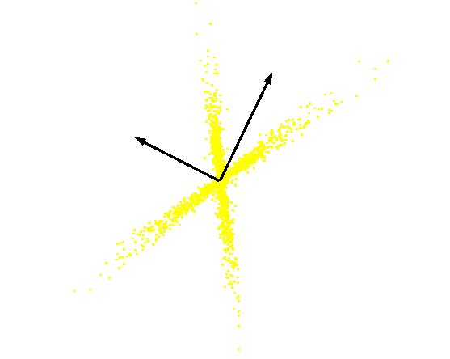
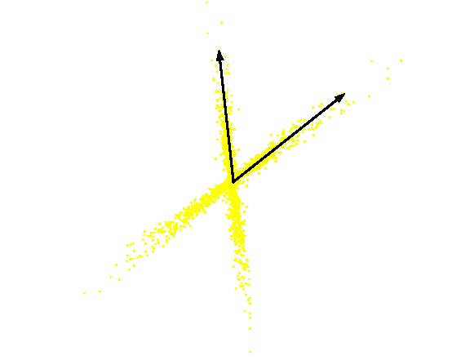
PCA vs ICA
PCA
(orthogonal coordinate)
ICA
(non-orthogonal coordinate)

Slide 34
Summary
PCA
Linear Dimensionality Reduction
Used for high-dimensional data
For PRML, can be considered as:
Learning latent variables
Pre-processing step to avoid “curse of dimensionality”
Treat coefficients as input data
There are nonlinear variants of this idea
We can formulate PCA using only dot products between input points… (any ideas?)

